Slide 1
Autonomous Cars
Daria Zahaleanu

Slide 2
Autonomous Cars and Safety
30% of the Americans cited safety concerns when asked if they would like to ride in a self-driving car
Autonomous cars must fight cyber attacks under California's new rules
Should the government be responsible for the cyber attacks against AVs? Where do automakers stand in this regard?

Slide 3
Why are ACs vulnerable to cyber attacks?
Electronic sensors commanded remotely using software
Increase in communication channels
Security Testing approaches
Possible attack consequences:
Manipulation of biometric authentication
Car crashes
Theft of illicit or illegal content

Slide 4
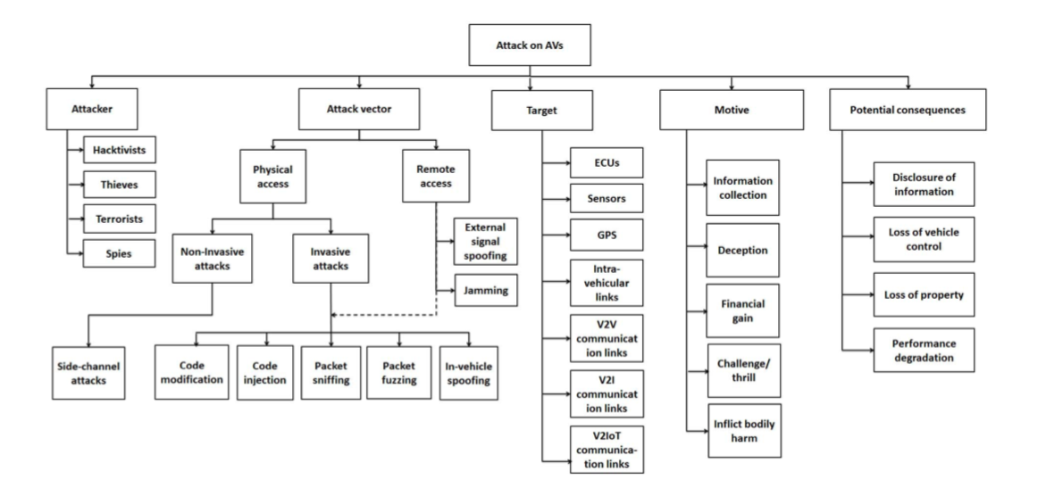
Attack Taxonomy

Slide 5
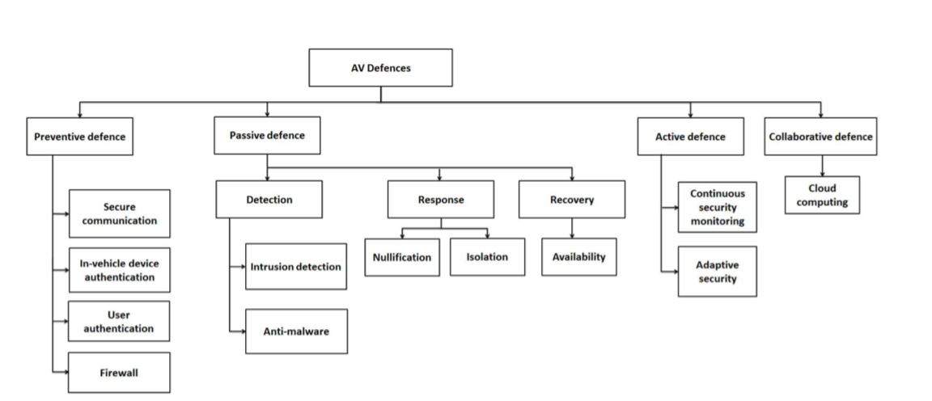
Defense Taxonomy

Slide 6
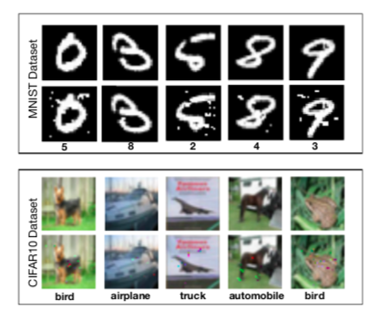
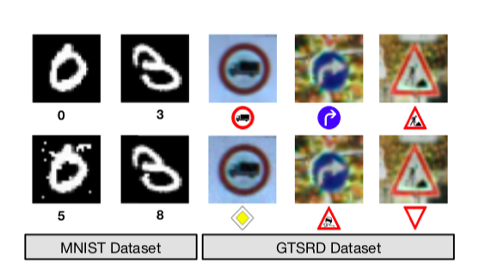
Adversarial Goal
In most of the cases, the adversary’s goal is to produce a minimally altered version of the input x (image, video, text etc) such that it changes the output of the DL model, without being perceptible to the human eye.

Slide 7
Types of Attacks
Defensive Distillation
Black - Box Attack
Robust Physical - World Attacks

Slide 8
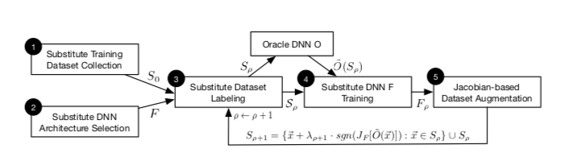
Substitute Model Training
Initial Collection of a set S0
Selecting an architecture F
Substitute Training
Jacobian Augmentation

Slide 9
Adversarial Sample Crafting
Goodfellow’s Algorithm
fast gradient sign method
δ⃗x = εsgn(∇⃗xc(F,⃗x,y)) . where perturbation sgn(∇⃗xc(F, ⃗x, y)) is the sign of the model’s cost function gradient.
2. Papernot’ Algorithm
Notes:
This algorithm is also known as the fast gradient sign method [4]. Given a modelF with an associated cost function c(F, ⃗x, y), the adversary crafts an adversarial sample x⃗∗ = ⃗x+δ⃗x for a given legitimate sample ⃗x by computing the following perturbation:
δ⃗x = εsgn(∇⃗xc(F,⃗x,y)) (5)
where perturbation sgn(∇⃗xc(F, ⃗x, y)) is the sign of the model’s cost function 2 gradient. The cost gradient is computed with respect to ⃗x using sample ⃗x and label y as inputs. The value of the input variation parameter ε factoring the sign matrix controls the perturbation’s amplitude. Increasing its value increases the likelihood of x⃗∗ being misclassified by modelF but on the contrary makes adversarial samples easier to detect by humans.

Slide 10
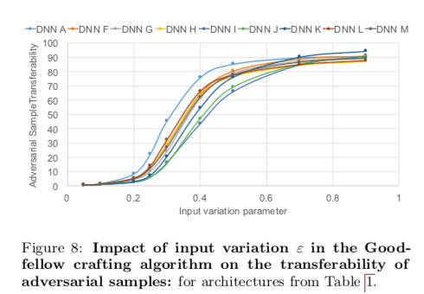
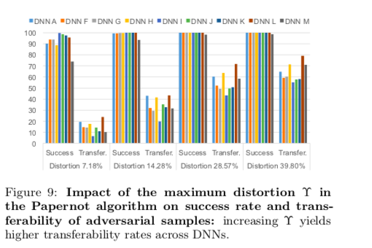
Success and Transferability Rate

Slide 11
Defense Strategies
Adversarial Training
Distillation

Slide 12
References
L.L. Thing, Vrizlynn & Wu, Jiaxi. (2016). Autonomous Vehicle Security: A Taxonomy of Attacks and Defences. 164-170. 10.1109/iThings-GreenCom-CPSCom-SmartData.2016.52.
Papernot, Nicolas & McDaniel, Patrick & Jha, Somesh & Fredrikson, Matt & Berkay Celik, Z & Swami, Ananthram. (2015). The Limitations of Deep Learning in Adversarial Settings.
Papernot, Nicolas & McDaniel, Patrick & Wu, Xi & Jha, Somesh & Swami, Ananthram. (2016). Distillation as a Defense to Adversarial Perturbations Against Deep Neural Networks. 582-597. 10.1109/SP.2016.41.
Papernot, Nicolas & McDaniel, Patrick & Goodfellow, Ian & Jha, Somesh & Berkay Celik, Z. & Swami, Ananthram. (2016). Practical Black-Box Attacks against Machine Learning. eprint arXiv:1602.02697.
Szegedy, Christian & Zaremba, Wojciech & Sutskever, Ilya & Bruna, Joan & Erhan, Dumitru & Goodfellow, Ian & Fergus, Rob. (2013). Intriguing properties of neural networks.
Evtimov, Ivan & Eykholt, Kevin & Fernandes, Earlence & Kohno, Tadayoshi & Li, Bo & Prakash, Atul & Rahmati, Amir & Song, Dawn. (2017). Robust Physical-World Attacks on Machine Learning Models.

